Slide 1



Library
Management
System
Submitted by:
ANKITA(2013986002)
ANUBHAV(2013986018)
MAYANK(201398601 )

Slide 2
INTRODUCTION
A library management system, also known as an automated library system is software that has been developed to handle basic housekeeping functions of a library.
It’s a well organized software solution for a library.
It help to provide information on any book present in library to the user as well as staff member.
It keeps a track of book issued, returned and added to library.

Slide 3
SCOPE OF PROJECT
To make the existing system more efficient.
To provide a user friendly environment where user can be serviced better.
Make functioning of library faster.
Provide a system where the library staff can catch defaulters and not let them escape.
To minimize the loss done to books.

Slide 4
PROJECT AIM AND OBJECTIVE
To eliminate the paper work in library.
To record every transaction in computerized system so that problem such as record file missing won’t be happen.
To design a user friendly graphical user interface which suit the user.
To save the cost and time.

Slide 5
DATA FLOW DIAGRAM
A data flow diagram(DFD) is graphical representation of the “flow” of data through an information system.
A DFD shows what kinds of information will be input to and output from the system.
One of the most widely used system analysis process models is the data flow diagram.

Slide 6
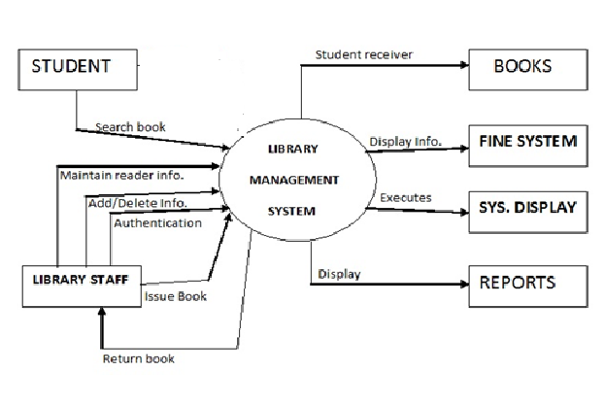
CONTEXT LEVEL DFD

Slide 7
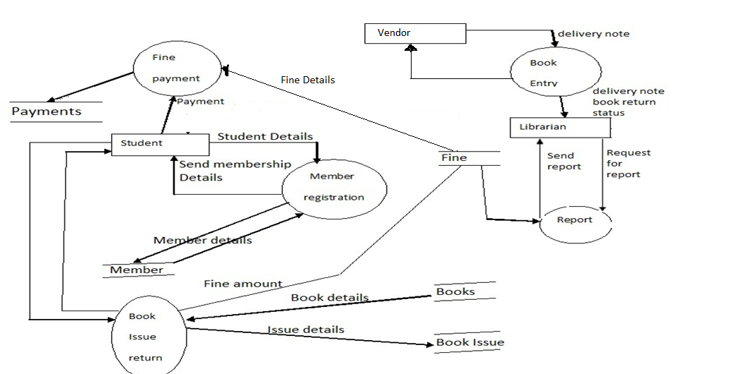
0 LEVEL DFD

Slide 8
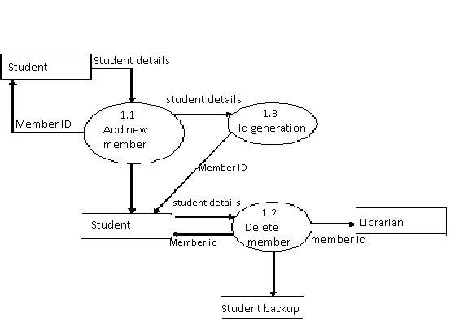
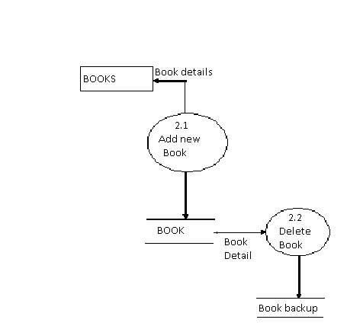
1 LEVEL DFD

Slide 9
MODULES
LOGIN
SIGNUP
BOOKS
BOOK SEARCH

Slide 10
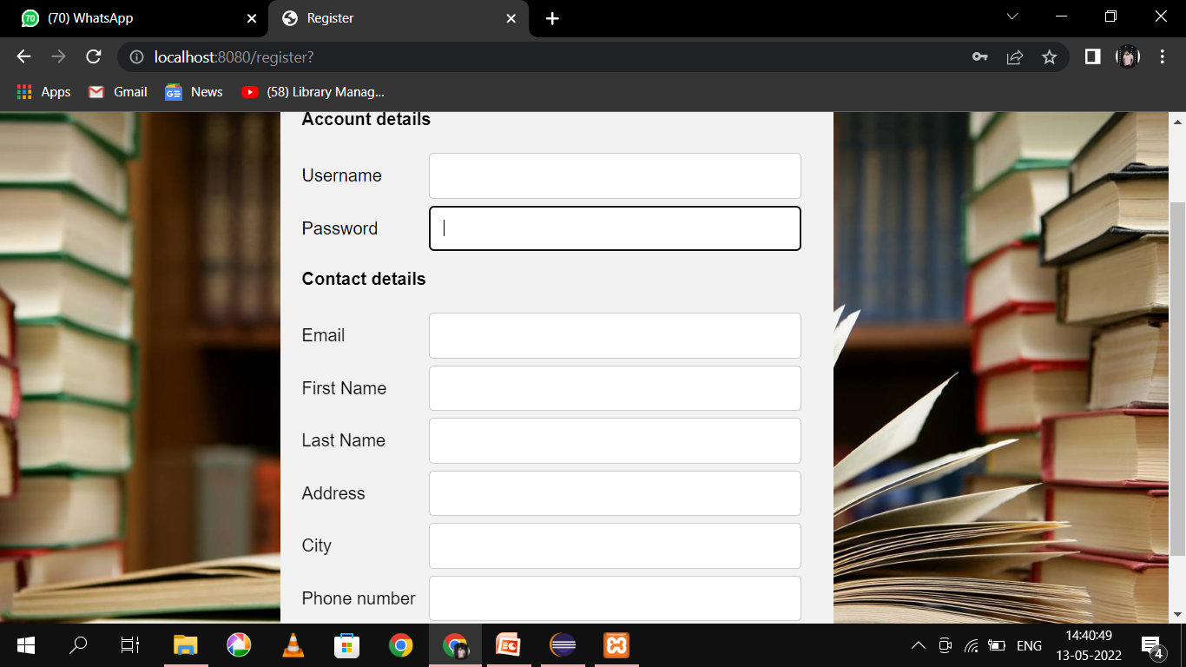


LOGIN PAGE

Slide 11
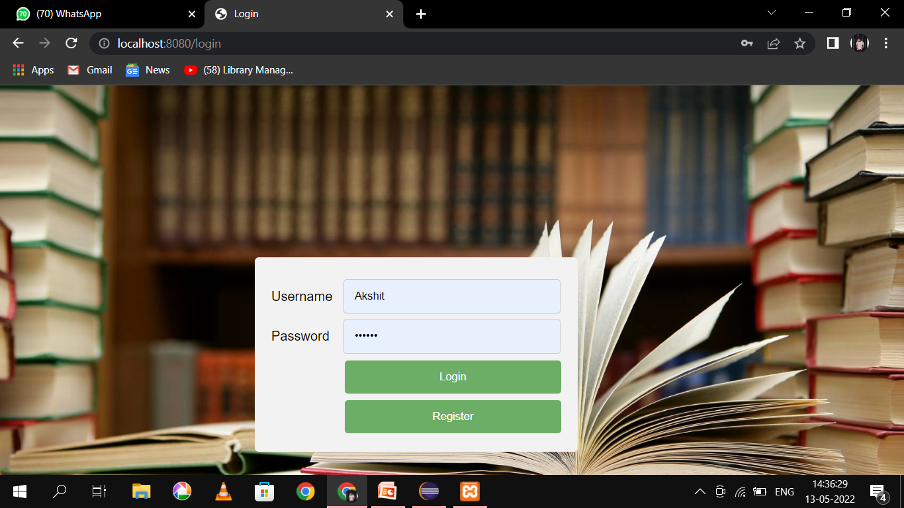







LOGIN PAGE
ABCD

Slide 12
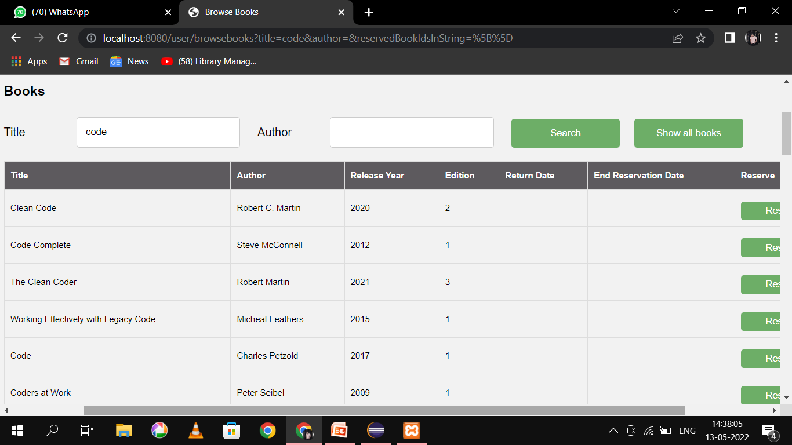

Slide 13
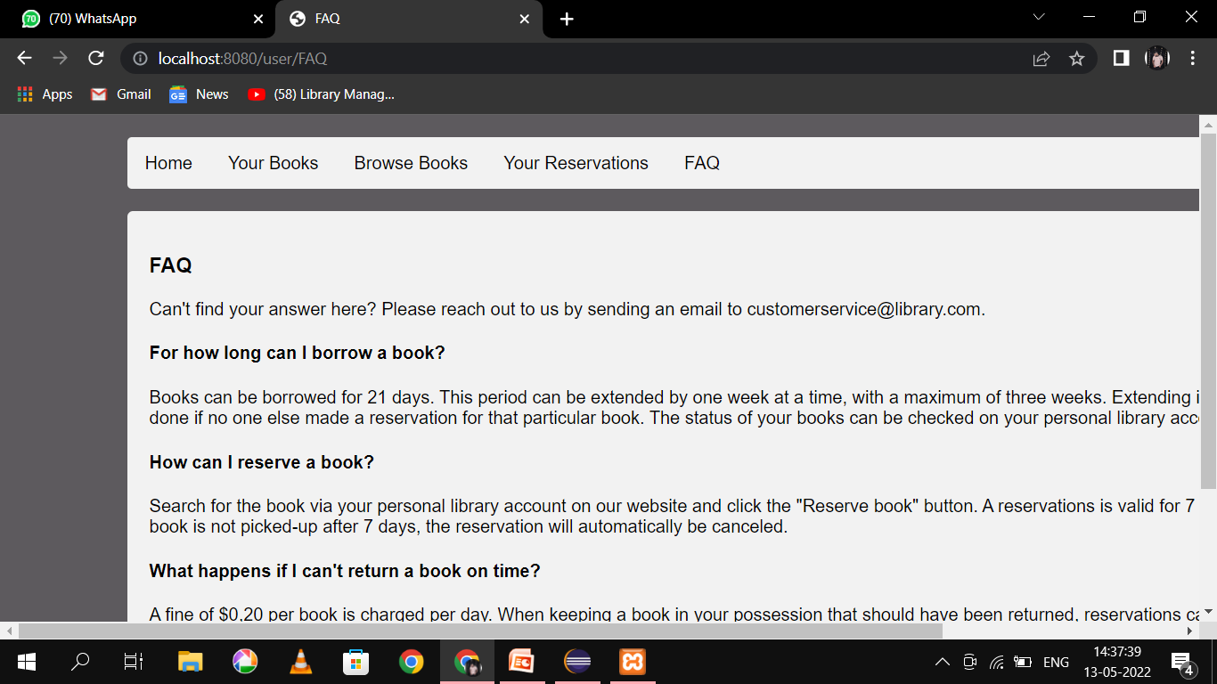

Slide 14
PROJECT OUTCOME
To make the existing system more efficient.
To provide a user friendly environment where user can be serviced better.
Make functioning of library faster.
Provide a system where the library staff can catch defaulters and not let them escape.
To minimize the loss done to books.

Slide 15
CONCLUSION
The system has been developed using ASP and MS access , the system was able to process and update the database with more ease. It helped in developing a total integrated system.
Thus the project “LIBRARY MANAGEMENT SYSTEM” can be altered in accordance with the future requirements of the organization.

Slide 16
THANK YOU!

